Slide 1

Data Exploration: Spotify Songs
By Eric Lin

Slide 2
Spotify/YouTube Data Set
This dataset contained 26 variables for a variety of songs collected from Spotify.
Some of these variables include:
Track name
Artist
Album Type
Danceability
Energy
Key
Loudness
Speechiness
Acousticness
Instrumentalness
The variables I used in my tests include:
YouTube Views
Spotify Streams
Album Type
Energy
Valence
Speechiness
Duration
Data Set: https://www.kaggle.com/datasets/salvatorerastelli/spotify-and-youtube?resource=download

Slide 3

Special Variable #1: Energy
Energy is predefined from the dataset and is a measure between 0.0 and 1.0.
Represents a measure of intensity and activity usually attributed to songs that feel fast, loud, and noisy.
The features used to define this variable are: dynamic range, perceived loudness, timbre, onset rate, and general entropy.
Ex: Metal music would be on the higher spectrum while a Bach prelude would be on the lower spectrum.

Slide 4

Special Variable #2: Speechiness
Speechiness is predefined from the dataset and is a measure between 0.0 and 1.0.
Represents the more exclusively speech-like a song is.
Songs with value 0.66 or above are most likely entirely words, 0.33 to 0.66 are typical songs with lyrics and music, and below 0.33 are fewer lyric songs or completely instrumental.
Ex: Talk shows and audio books fit above the 0.66 range while rap music fits between the 0.33 to 0.66 range.

Slide 5


Special Variable #3: Valence
Valence is predefined from the dataset and is a measure between 0.0 and 1.0.
Represents the musical positiveness.
Happier cheerful tracks have more valence while sad or depressed tracks have lower valence.
Ex: Music in major keys would score higher valence while minor keys would be have lower valence.

Slide 6

Normal Variables
Normal Variables are data generated directly from Spotify or YouTube analytics.
YouTube Views: the number of times a video has been viewed.
Spotify Streams: the number of times a song has been played.
Album Type: the type of album the song belongs to, i.e. single, compilation, album.
Duration: the duration of the song in milliseconds.

Slide 7
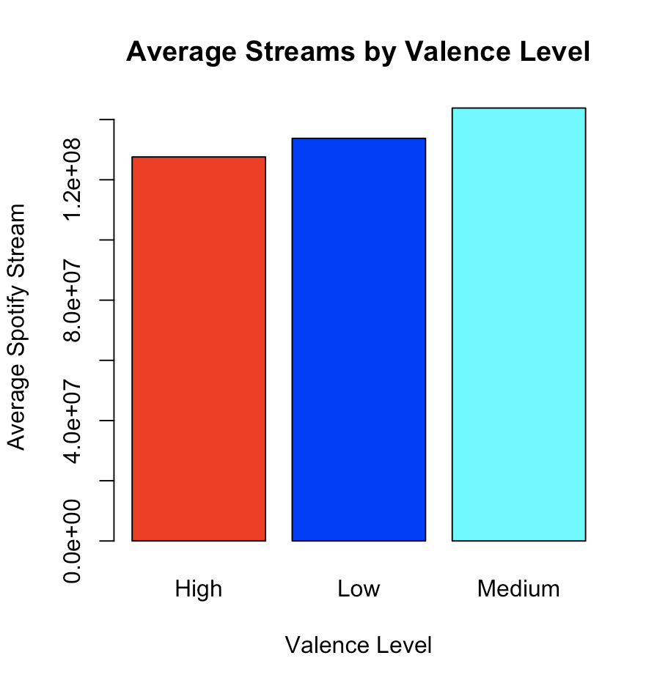
Test 1: Valence vs Spotify Streams
Initial Hypothesis: People tend to listen to music to cheer up or set themselves in a certain mood, therefore, cheerful sounding songs should have more streams than those that sound more dark and depressing.
Test Steps:
1.) Separate valence levels into three categories:
high, medium, and low.
2.) Compare the average Spotify streams in each category.
Conclusion: Surprisingly, people tend to listen to songs that
are more on the darker side instead.

Slide 8
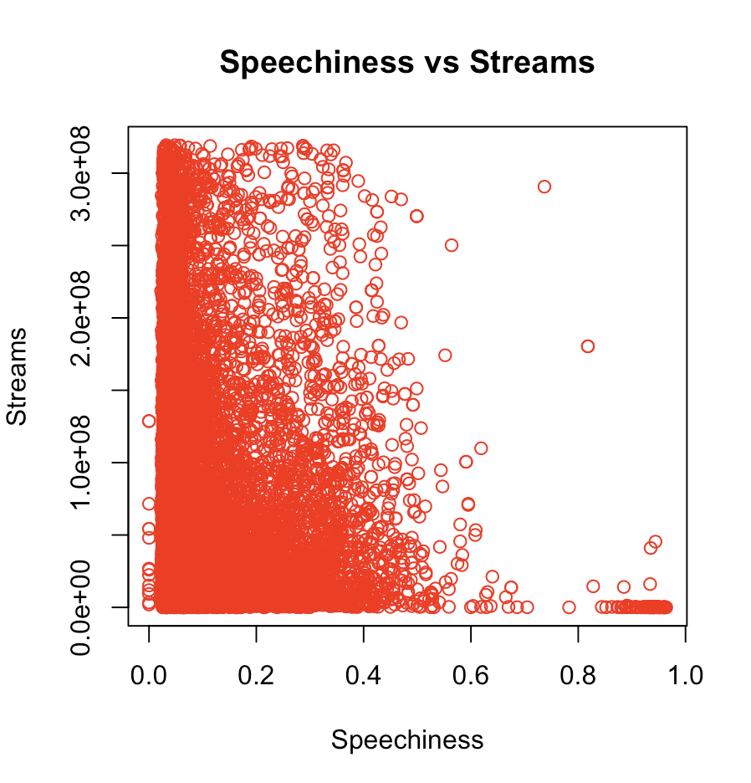
Test 2: Speechiness vs Spotify Streams
Initial Hypothesis: Mainstream music is usually pop or rap, therefore popular songs should be somewhat in the middle in terms of speechiness (around 0.33 to 0.66).
Test Steps:
1.) Remove the outliers from number of streams.
2.) Compare the speechiness vs number streams.
Conclusion: Surprisingly, a majority of the most streamed
songs are ones with fewer lyrics between
Around 0.02 to 0.30.

Slide 9
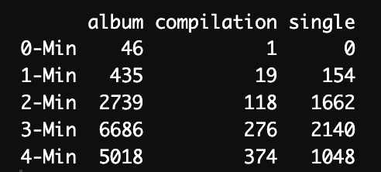
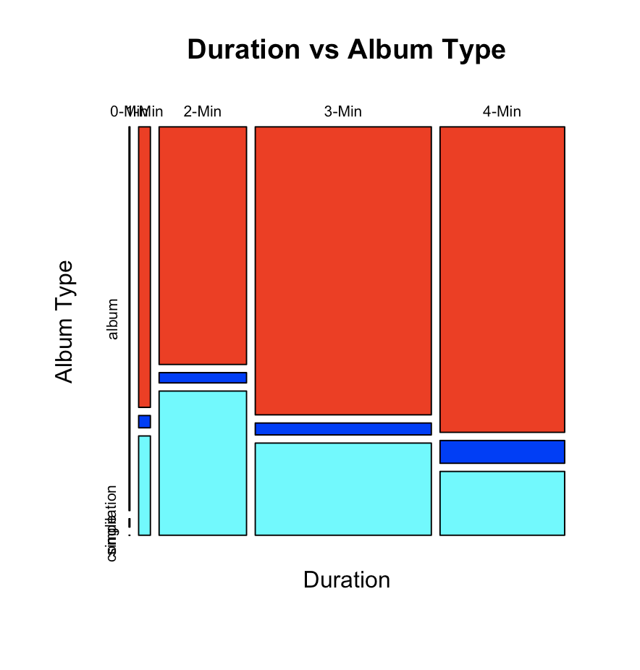
Test 3: Duration vs Album Type
Initial Hypothesis: Different album types should have different song lengths. Songs in an album should be shorter while songs as a single should typically be longer than their counterparts.
Test Steps:
1.) Separate durations into minute categories:
4m, 3m, 2m and 0m.
2.) Compare the durations vs album types.
Conclusion: Interestingly, album songs were the only songs that were less than 1 minute long, but at the
same time, they were the songs with the most
4 minute songs. Therefore it’s inconclusive to
say that typically singles are longer than
album songs.

Slide 10
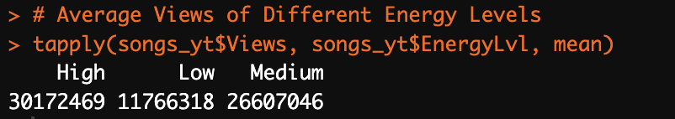
Expected Test: Energy vs YouTube Views
Initial Hypothesis: The higher the energy, the more popular the song should be, therefore, the higher the views.
Test Steps:
1.) Separate energy into three categories: high, medium, and low.
2.) Remove outliers viewing outliers.
2.) Compare the energy level vs average number of views.
Conclusion: As expected, the higher the energy of the
song, the higher the YouTube views.

Slide 11
The End

